Slide 1
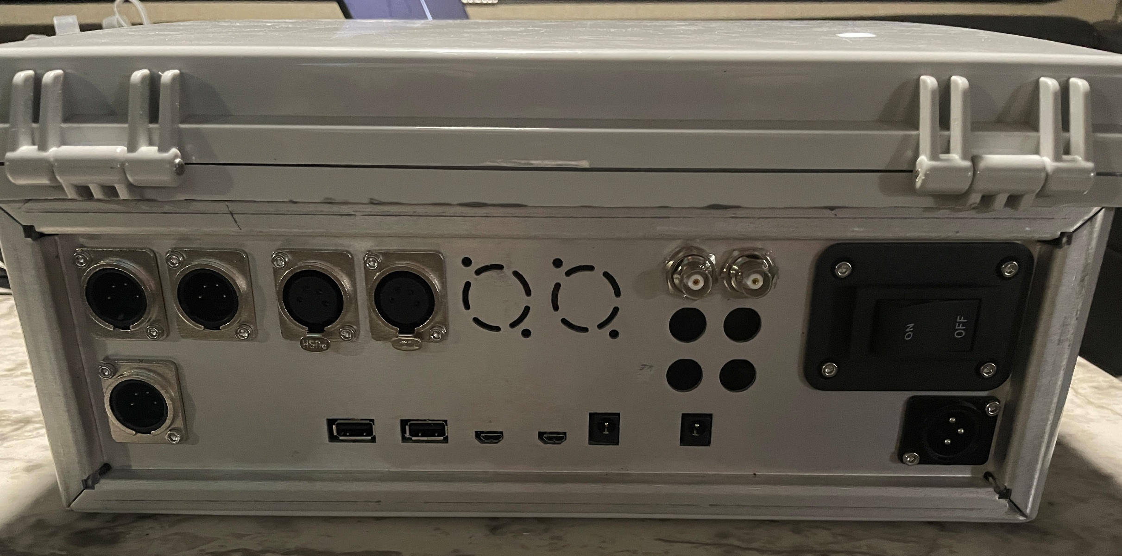
CAN Bus
Valve Control
GPS Ant
RTK Ant
Spare USB
For Primary Tablet
Tablet USB
16V Tablet Pwr Out
12V Battery In

